Slide 1
Entertainment Industry & Simulations
Animation, Gaming, and the World of Simulations
Week 13 · Lectures 25 & 26

Slide 2
Contents
01
Entertainment Industry
Animation Industry · Game Industry
02
Simulations and Their Uses
Types, Applications, and Future Trends
02

Slide 3

01
Entertainment Industry
Exploring Animation and Game Industry

Slide 4
The Digital Entertainment Landscape
The entertainment industry driven by computer graphics is one of the world's largest economic forces.
• Animation and gaming are the largest CG entertainment segments
• Spanning film, TV, streaming, and mobile
• Tech convergence blurs boundaries
Industries share 3D rendering, real-time engines, AI for different audiences.
$430B
$189B
Animation Market (2025)
Games Market (2025)
Source: Precedence Research, Newzoo 2025 Global Games Market Report
04

Slide 5
Animation Industry Overview
3D Animation
2D Animation
Stop Motion
• Leads with 61.2% market share
• CGI modeling, rigging, rendering
• Feature films, AAA games, VR
• Photorealistic visuals
Examples: Avatar, Toy Story, Spider-Verse
• Cost-effective production
• Digital vector-based art
• Streaming & social media
• Mobile games, web series
5.8% CAGR growth via Netflix, YouTube, TikTok
• Physical puppets & models
• Frame-by-frame photography
• Unique tactile aesthetic
Examples: Coraline, Wallace and Gromit, Isle of Dogs
05

Slide 6
Animation Market by the Numbers
$430B
61.2%
50.8%
$59.3B
Global Market (2025)
3D Animation Share
OTT Revenue Share
U.S. Market (2024)
6.1% CAGR through 2035
Dominant segment
Netflix, Disney+, Prime
8.3% CAGR
06

Slide 7
Animation Market by the Numbers
$430B
61.2%
50.8%
$59.3B
Global Market (2025)
3D Animation Share
OTT Revenue Share
U.S. Market (2024)
6.1% CAGR through 2035
Dominant segment
Netflix, Disney+, Prime
8.3% CAGR
06

Slide 8
Animation Industry Key Players
Disney / Pixar
DreamWorks
Sony Pictures
Japan Studios
Tech Leaders
Streaming
Industry pioneers
Toy Story, Frozen
Storytelling leaders
Shrek, Kung Fu Panda
How to Train Dragon
Comedy & adventure
Spider-Verse franchise
Cutting-edge visuals
Innovation leader
TOEI, Kyoto Anim.
Anime global hit
Dragon Ball, Demon Slayer
Adobe, Autodesk, NVIDIA
Tools & rendering
AI-powered workflows
Netflix, Disney+, Prime
Billions in content
50.8% of revenue
Key Insight: OTT platforms now drive 50.8% of animation revenue, reshaping the industry
07

Slide 9
Technology Trends in Animation
01 Real-Time Rendering
Unreal Engine & Unity enabling faster production pipelines, reducing render times from hours to seconds
02 AI-Powered Animation
Generative AI automating in-betweening, texturing, and scene generation; market growing at 39.8% CAGR
03 Virtual Production
LED volume stages blending live-action and CG in real-time (The Mandalorian model)
04 Cloud Collaboration
Remote distributed teams using cloud rendering and shared asset libraries
05 Immersive Media
VR/AR animation for spatial computing platforms like Apple Vision Pro and Meta Quest
06 Cloud Rendering
Democratizing access to high-end rendering for studios of all sizes
AI animation market: $652M (2024) → projected $13.4B (2033) — a 20x growth trajectory
08

Slide 10
Game Industry Overview
The global games market generates $188.8B in 2025 (+3.4% YoY)
• 3.6 billion players worldwide
• Shifting from volume-driven to value-driven growth
• Asia-Pacific leads with $87.6B (46% share)
Top 2 markets:
• China: $49.8B
• United States: $49.6B
Together accounting for half of global spending
Source: Newzoo Global Games Market Report 2025
09

Slide 11
Gaming Platforms and Segments
Mobile Gaming
Console Gaming
PC Gaming
$103B
55% of market
• Largest segment
• +2.9% YoY
• Slowing in East Asia
• Growing in West
Top: Genshin Impact
$45.9B
Fastest-growing (+5.5%)
• Nintendo Switch 2
• Higher software prices
• Strong release calendar
• Boom 2025–2028
Key: GTA VI
$39.9B
+2.5% stable growth
• China & Japan momentum
• Cross-platform releases
• Live-service thriving
Steam Early Access for indies
10

Slide 12
Gaming Industry Key Players
Platform Holders — "The Big 3"
• Nintendo, Microsoft, Sony
• $45B+ quarterly revenue
Major Publishers
• Tencent — global revenue leader
• Activision Blizzard, EA, Take-Two
• Ubisoft (Assassin's Creed)
Asia-Pacific Powerhouses
• Bandai Namco, Capcom, Square Enix
• NetEase, Nexon driving innovation
Creator Economy
UGC Platforms
• Roblox: $923M payouts, 1.6M creators
• Fortnite: $352M payouts
Key Stats
• Combined payouts: $1.5B+ (2025)
• 40% gamers consuming more UGC
• 56% of Roblox players under 16
UGC democratizes game creation
11

Slide 13
Trends Shaping the Future of Gaming
4 Key Trends
1. GenAI
~20% of new games use AI
2. UGC Expansion
$1.5B+ creator payouts
3. Cloud Gaming
60% of players tried it
4. Open App Stores
Lower fees, new distribution
Source: BCG Video Gaming Report 2026, Newzoo 2025
12

Slide 14
Animation vs. Game Industry
Dimension | Animation Industry | Game Industry
Market Size (2025) | $430 billion | $189 billion
Growth Rate | 6.1% CAGR (2026–2035) | 3.1% CAGR (2022–2027)
Primary Revenue | OTT, licensing, advertising | Hardware, software, in-app purchases
Top Region | North America (40%) | Asia-Pacific (46%)
Tech Focus | Rendering, real-time CG, AI | Interactivity, cloud, AI NPCs
Career Outlook | 8% job growth (2022–2032) | Steady demand for AI/cloud skills
Sources: Precedence Research, Newzoo, U.S. Bureau of Labor Statistics
13

Slide 15

02
Simulations and Their Uses
From virtual training to scientific modeling

Slide 16

What Are Computer Simulations?
A computer simulation imitates real-world processes using computational models.
Simulations use math models and computer graphics for safe experimentation.
Core Components:
• Mathematical modeling
• 3D visualization
• Real-time interaction
• Data analysis & feedback
Simulations bridge theory and practice across science, medicine, and engineering.
Key Principle:
Simulations let us explore "what-if" scenarios safely — from training surgeons to predicting climate.
15

Slide 17
Types of Simulations
Physical Simulations
Process Simulations
VR Simulations
Weather modeling, fluid dynamics, structural stress analysis, and collision detection
Manufacturing workflows, supply chain optimization, and business process modeling
Immersive training with HMDs and haptic feedback for medical, military, and aviation
Agent-Based
Monte Carlo
Discrete Event
Modeling individual behaviors in crowds, traffic flow, disease spread, and ecosystems
Statistical probability modeling for finance, risk assessment, and investment strategies
Modeling queued systems like hospital ERs, airport operations, and manufacturing lines
Each simulation type addresses different problems — from predicting weather to training surgeons
16

Slide 18
Medical and Healthcare Simulations
VR medical simulations create lifelike clinical scenarios for risk-free training.
Key Applications:
• Surgical — VR improves by 230%
• Anatomy — Stanford VR brain prep
• Nursing — patient care scenarios
• Emergency — trauma response
Key Benefits:
• No risk to patients
• Unlimited practice
• Objective assessment
• Reduced costs
230%
68%
Performance boost with VR
of U.S. medical schools adopted VR/AR
$11B
27%
Projected VR healthcare market
Faster decision-making in emergencies
Sources: Imperial College London, AAMC, University of Maryland
17

Slide 19
Military and Aviation Simulations
From mechanical Link Trainers to AI-powered VR — a century of simulation evolution
Early Flight Sims
• Link Trainer
• Mechanical sims
• Pilot training
Full Immersion
• Motion platforms
• Full-flight simulators
• Military war-gaming
1920s
1970s–80s
2000s
Today
Digital Revolution
• Computer-based sims
• CGI visuals
• ~50% crash reduction
AI + VR Era
• AI adversaries
• VR combat training
• Cost-effective ops
Aviation industry credits simulation for ~50% reduction in human error-related crashes since 1970s
18

Slide 20
Engineering and Scientific Simulations
Engineering
• FEA — structural testing without prototypes
• CFD — aerodynamics and airflow
• Crash tests — saving millions
• Digital Twins — predictive maintenance
Scientific
• Climate — weather and climate prediction
• Molecular — drug discovery, protein folding
• Astrophysics — black holes, galaxies
• NASA — spacecraft and mission planning
Automotive
Aerospace
Pharma
Digital Twins
Virtual crash tests save millions per vehicle
NASA uses sims for mission planning
Molecular modeling accelerates drug discovery
Virtual replicas for predictive maintenance
19

Slide 21
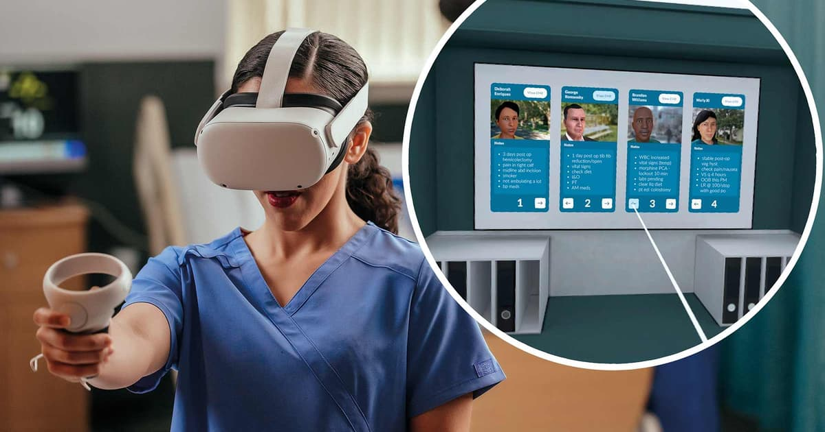
VR/AR in Training and Education
VR Training Advantages:
• Replicates any condition in any environment
• Consistent, standardized experiences
• Objective performance tracking
• Geographic flexibility
Key Statistics:
• VR surgeons: 230% improvement
• Emergency decisions: 27% faster
• AR spatial awareness: +42%
Sources: Imperial College, Univ. of Maryland
Training Applications:
• Medical — surgery, anatomy
• Corporate — soft skills
• Safety — firefighting, oil rigs
• Education — virtual labs
20

Slide 22
Benefits of Simulation-Based Training
Risk-Free
Cost Efficient
Standardized
Scalable
Analytics
Retention
Practice dangerous procedures safely
~1/10th the cost of physical sims
Identical training for all learners
Train many across locations
Track actions and decisions
Immersive practice improves retention
VR simulation costs approximately 1/10th of physical simulation while delivering equal or better learning outcomes
21

Slide 23
Simulations in Education
Medical Schools
• VR anatomy labs complement cadavers
• Stanford teaches in Kenya remotely
STEM Education
• Virtual physics and chemistry labs
• Safe experimentation
Professional Development
• Nursing residencies with VR
• Emergency response training
Soft Skills
• Communication and empathy
• Crisis management
Research Findings
• Medical students using VR show higher knowledge gains vs. screen-based learning
• 84 nursing students study: same learning in VR and physical sim, but VR cheaper
• Multiplayer VR enables collaborative learning across continents
• VR reduces costs while maintaining outcomes
Sources: Stanford Medicine, University of Northampton, Oxford University Hospitals
22

Slide 24
The Future of Simulations
01 AI Integration
Dynamic scenarios adapting to learner performance; intelligent tutoring systems
02 Haptic Feedback
Touch sensation making VR more realistic for surgical training
03 Digital Twins
Real-time virtual replicas of cities, factories, and supply chains
04 Metaverse Training
Persistent virtual training worlds for continuous development
05 5G + Cloud Streaming
High-fidelity simulations streamed to any device
06 Global Collaboration
Multiplayer VR enabling cross-cultural team training
Simulation is evolving from occasional training events to continuous practice — like going to the gym for your skills
23

Slide 25
Entertainment and Simulation Convergence
The boundaries between entertainment and simulation are rapidly blurring
Entertainment → Simulation
Simulation → Entertainment
• Unreal Engine & Unity power games and training
• Virtual production uses game engine rendering
• Military uses modified game tech (serious games)
• Medical VR leverages gaming immersion
• Flight sims evolved from entertainment software
• Digital humans and AI NPCs serve both fields
• Physics engines create realistic virtual worlds
• Shared career pathways in CG and media
This convergence creates shared technology ecosystems and career pathways across industries
24

Slide 26
Key Takeaways
Animation ($430B) and Gaming ($189B) drive digital entertainment with AI, cloud, and immersive technologies
Simulations transform training across medicine, aviation, military, and education
The convergence of entertainment and simulation creates new possibilities
Week 13 · Entertainment Industry & Simulations

